Slide 1
SQLite Local Database
A Developer's Guide to
Windows 10 Insider Preview Andy & Jerry

Slide 2
Why Use a Database?
Why SQLite?
.NET APIs: SQLite-NET, SQLiteWinRT and others
SQLitePCL – The Basics
Transactions, Relations and other Constraints
Tools

Slide 3

Complex Schema
Numerous relationships and constraints
Example: Shopping List
7 tables
100s of records
5 foreign keys

Slide 4

Reference Data
Huge amounts of static reference data
Example: dictionary app
3 tables
1 table with 500k rows

Slide 5
Why SQLite?
Worlds’ most popular database
Widely used on iOS, Android, Python, Mono etc…
Public Domain
Small, Fast, Reliable
Rich Features
Embedded SQL in-process database engine
Read/writes to ordinary disk files
Supports multiple tables, indices, triggers and views
Cross-platform – freely copy database files between 32-bit and 64-bit, or little endian and big endian
Reliable
Reputation for being very reliable
Large automated test suite
All transactions are ACID even if interrupted by system crashes or power failures

Slide 6
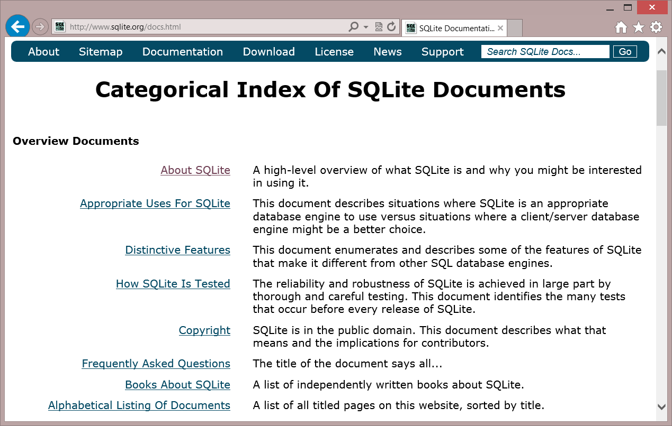
SQLite.org
Documentation
SQL Syntax
C/C++ API Reference
Source and tools download

Slide 7
Choice of .NET APIs
SQLitePCL SQL statements Thin wrapper around the SQLite C API
SQLite-NET
LINQ syntax Lightweight ORM
var db = new SQLite.SQLiteAsyncConnection(App.DBPath);
var _customer = await (from c in db.Table<Customer>() where c.Id == customerId select c).FirstOrDefaultAsync(); if (customer != null) { var Id = _customer.Id; var Name = _customer.Name; }
using (var conn = new SQLiteConnection("demo.db")) { Customer customer = null;
using (var statement = conn.Prepare( "SELECT Id, Name FROM Customer WHERE Id = ?"))
{
statement.Bind(1, customerId);
if (SQLiteResult.DONE == statement.Step()) {
customer = new Customer() {
Id = (long)statement[0],
Name = (string)statement[1] };
}
}
}
…and others!

Slide 8
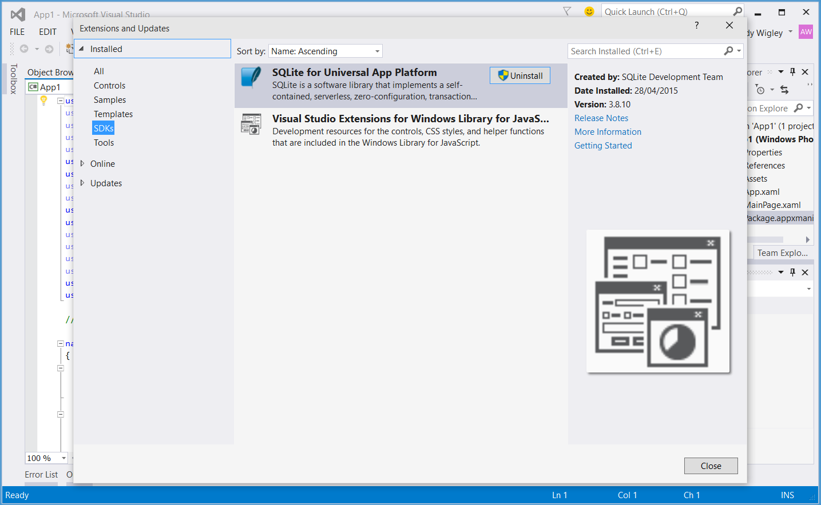
Installing the SQLite Library
Visual Studio Extension (.vsix)
Install from Visual Studio
Tools – Extensions and Updates…
Or download from SQLite.org

Slide 9
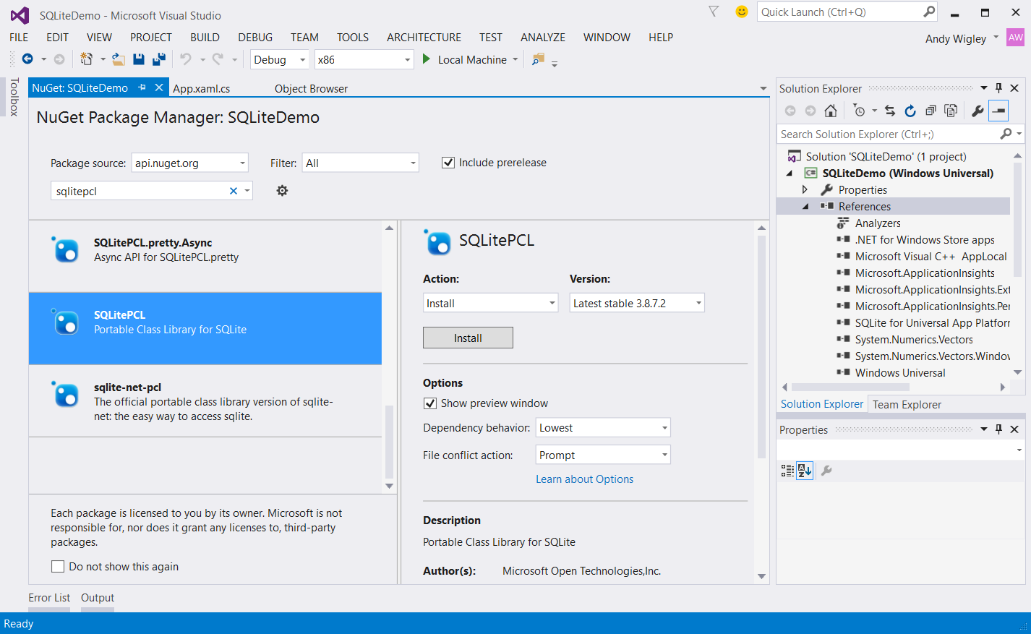
Installing SQLitePCL to your Solution

Slide 10
SQLitePCL The basics

Slide 11
Defining tables
SQLitePCL is really a thin wrapper around the SQLite ‘C’ API
Interact with the database using
SQL statements
Parameterized queries and statements

Slide 12
Create database and tables
private void LoadDatabase() { // Get a reference to the SQLite database conn = new SQLiteConnection("sqlitepcldemo.db"); string sql = @"CREATE TABLE IF NOT EXISTS Customer (Id INTEGER PRIMARY KEY AUTOINCREMENT NOT NULL, Name VARCHAR( 140 ), City VARCHAR( 140 ), Contact VARCHAR( 140 ) );"; using (var statement = conn.Prepare(sql)) { statement.Step(); } }

Slide 13
Insert
// SqlConnection was opened in App.xaml.cs and exposed through property conn var db = App.conn; try { using (var custstmt = db.Prepare("INSERT INTO Customer (Name, City, Contact) VALUES (?, ?, ?)")) { custstmt.Bind(1, customerName); custstmt.Bind(2, customerCity); custstmt.Bind(3, customerContact); custstmt.Step(); } } catch (Exception ex) { // TODO: Handle error }

Slide 14
Select
public Customer GetCustomer(int customerId) { Customer customer = null; using (var statement = dbconn.Prepare("SELECT Id, Name, City, Contact FROM Customer WHERE Id = ?")) { statement.Bind(1, customerId); if (SQLiteResult.DONE == statement.Step()) { customer = new Customer() { Id = (long)statement[0], Name = (string)statement[1], City = (string)statement[2], Contact = (string)statement[3] }; } } return customer; }

Slide 15
Update
// See if the customer already exists var existingCustomer = GetCustomer(customer.Id); if (existingCustomer != null) { using (var custstmt = dbconn.Prepare("UPDATE Customer SET Name = ?, City = ?, Contact = ? WHERE Id=?")) { // NOTE when using anonymous parameters the first has an index of 1, not 0. custstmt.Bind(1, customer.Name); custstmt.Bind(2, customer.City); custstmt.Bind(3, customer.Contact); custstmt.Bind(4, customer.Id); custstmt.Step(); } }

Slide 16
Delete
public void DeleteCustomer(int customerId) { using (var statement = dbconn.Prepare("DELETE FROM Customer WHERE Id = ?")) { statement.Bind(1, customerId); statement.Step(); } }

Slide 17
SQLite using SQLitePCL

Slide 18
Transactions, relations and other constraints

Slide 19
Transactions
No changes can be made to the database except within a transaction
Any command that changes the database will automatically execute within a transaction if one is not already in effect
Transactions can be started manually using the BEGIN TRANSACTION statement
Such transactions persist until the next COMMIT TRANSACTION or ROLLBACK TRANSACTION
Transaction will also rollback if the database is closed

Slide 20
Manual transaction – SQLitePCL
SQLite-NET
using (var statement = dbconn.Prepare("BEGIN TRANSACTION")) { statement.Step(); } // Execute one or more statements… using (var custstmt = dbconn.Prepare( "INSERT INTO Customer (Name, City, Contact) VALUES (?, ?, ?)")) { ... } using (var projstmt = dbconn.Prepare( "INSERT INTO Project (Name, Title, DueDate, CustomerId) VALUES (?, ?, ?, ?)")) { ... } // COMMIT to accept all changes or ROLLBACK TRANSACTION to discard pending changes using (var statement = dbconn.Prepare(“COMMIT TRANSACTION")) { statement.Step(); }

Slide 21
Relations
Parent – Child relationship between records in one table and those in another
Example:
Each Customer has a collection of one or more Projects
Relationship represented in the database by a column in the child object which stores the ID of the parent
Foreign key constraints enforce the relationship and maintain db integrity

Slide 22
Creating foreign key constraints
With SQLiteWinRT, FK constraint is defined in the CREATE TABLE statement
CREATE TABLE IF NOT EXISTS Project
(Id INTEGER PRIMARY KEY AUTOINCREMENT NOT NULL,
CustomerId INTEGER,
Name VARCHAR( 140 ),
Description VARCHAR( 140 ),
DueDate DATETIME,
FOREIGN KEY(CustomerId) REFERENCES Customer(Id)
);

Slide 23
Enforcing foreign key constraints
Defining a foreign key constraint on the table is not enough!
Foreign key constraints are disabled by default (for backwards compatibility)
Must be enabled at runtime using a PRAGMA
// Turn on Foreign Key constraints
sql = @"PRAGMA foreign_keys = ON";
using (var statement = dbconn.Prepare(sql))
{
statement.Step();
}

Slide 24
Other constraints
Type | Description | SQLite-NET
PRIMARY KEY | Defines the column(s) of the primary key - 1 per table max | Declare by using [PrimaryKey] attribute
UNIQUE | Column constraint enforces unique values in that column | Declare by using [Unique] attribute
NOT NULL | Column constraint prevents null values | No way of declaring with SQLite.NET
CHECK | Column or Table constraint: constraint expression is evaluated on every insert or update, and if ‘0’ returned, constraint fails | No way of declaring with SQLite.NET
See http://sqlite.org/lang_createtable.html for more information

Slide 25
Indexes
Index is created automatically for PRIMARY KEY columns
Important to create indices on foreign key columns or columns used to select records from large tables
// Create index on Foreign Key column
sql = @"CREATE INDEX IF NOT EXISTS fk_customer_project_idx
ON project (customerId) ASC";
using (var statement = dbconn.Prepare(sql))
{
statement.Step();
}

Slide 26
tools

Slide 27
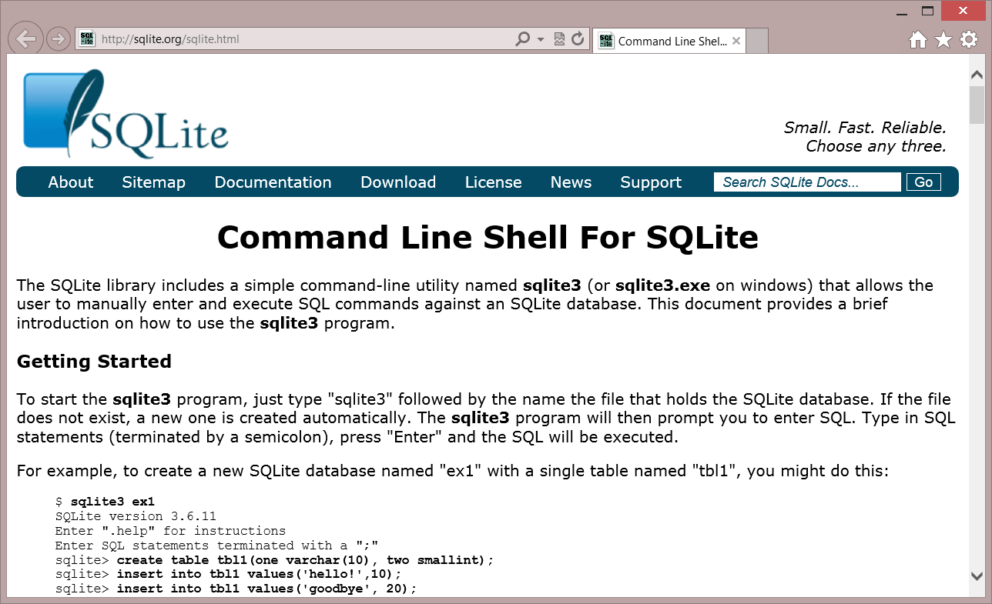
sqlite3.exe
Download command line tool from sqlite.org

Slide 28
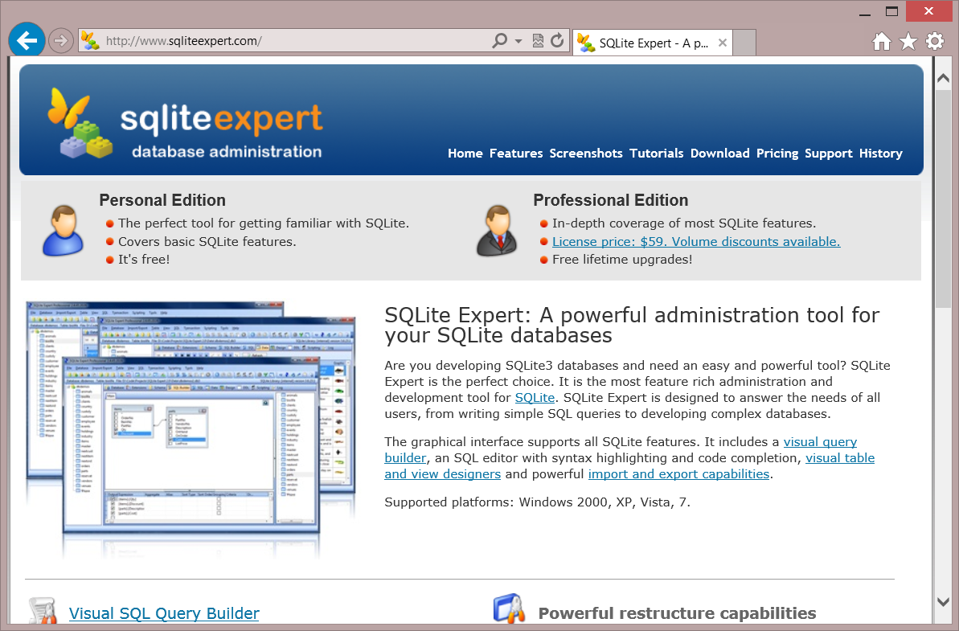
IDEs
For those who prefer a GUI, see the list of IDEs at http://www.sqlite.org/cvstrac/wiki?p=ManagementTools
Some popular ones include:
SQLite Studio http://sqlitestudio.pl/
SQLite Expert http://www.sqliteexpert.com/

Slide 29
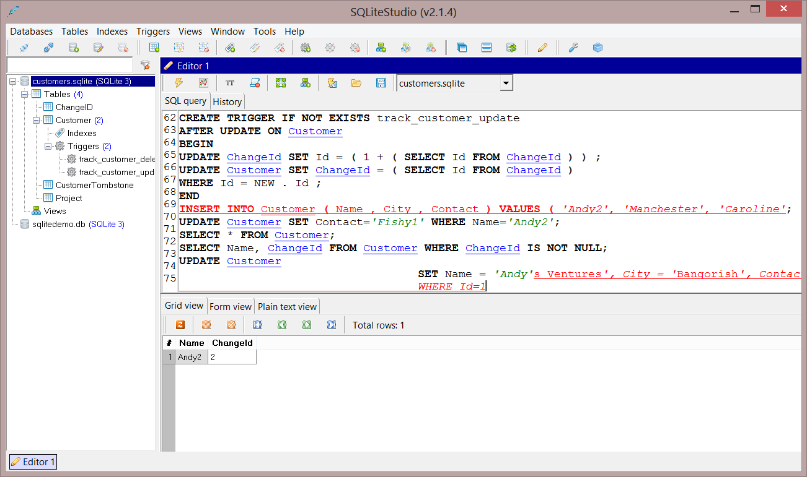
Useful debugging tool

Slide 30
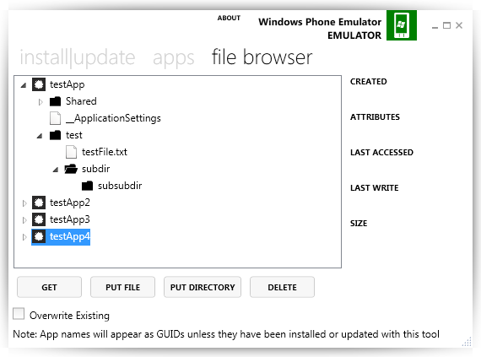
Transferring databases to desktop
For Desktop: go to %USERPROFILE%\AppData\Local\Packages\{PackageId}
For Mobile: Windows Phone Power Tools for WP8.1 – https://wptools.codeplex.com Still works with Windows 10 devices Although you must install the VS2013 – Windows Phone 8.0 SDK to install a device connectivity DLL dependency.

Slide 31
Tools
Tools

Slide 32

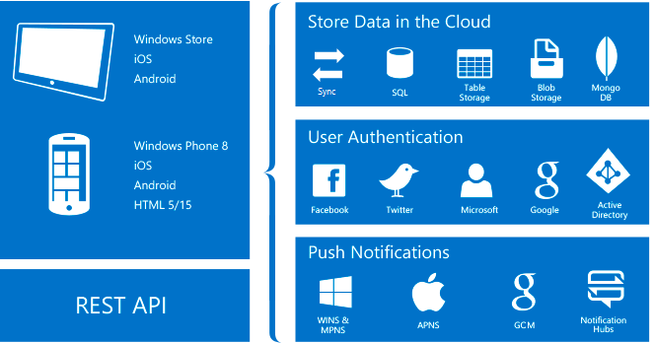

Frameworks that use SQLite
Azure App Service Mobile Apps
Entity Framework 7
01010 00100 10110 00100
Easy to implement offline data sync uses SQLite for local data storage
Lightweight ORM. Supports offline data sync using SQLite for local data storage
See BUILD session 2-693 Entity Framework 7
http://channel9.msdn.com/Events/Build/2015/2-693

Slide 33
Why Use a Database?
Why SQLite?
.NET APIs: SQLite-NET, SQLiteWinRT and others
SQLitePCL – The Basics
Transactions, Relations and other Constraints
Tools

